Slide 1
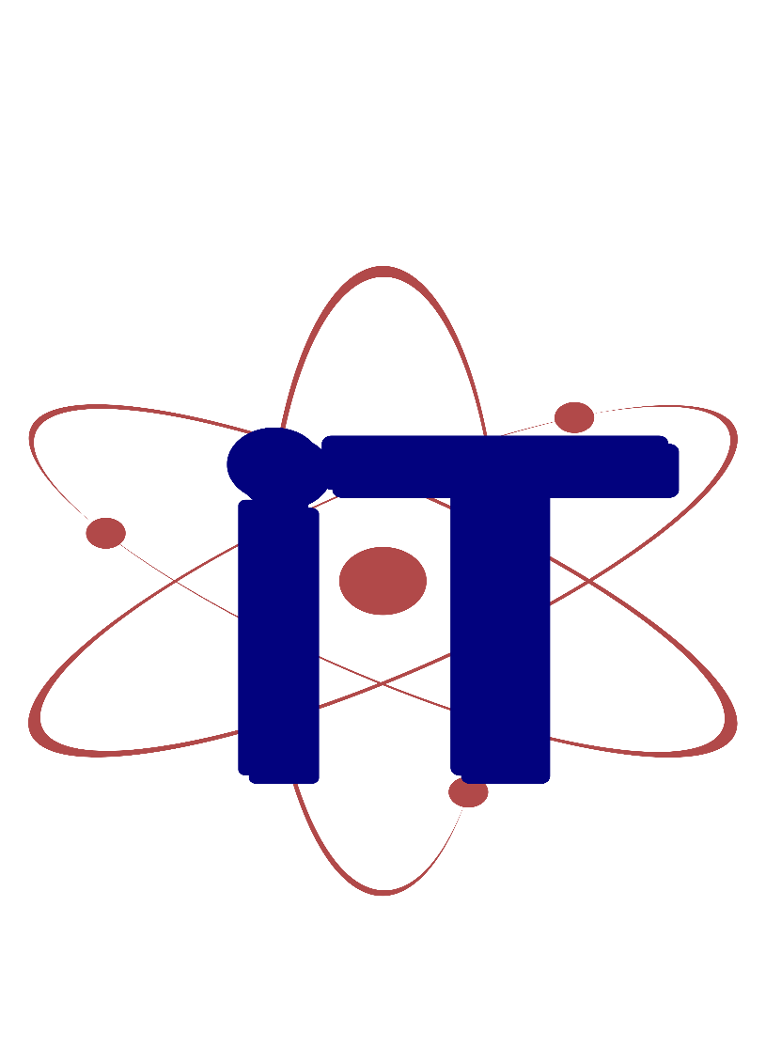


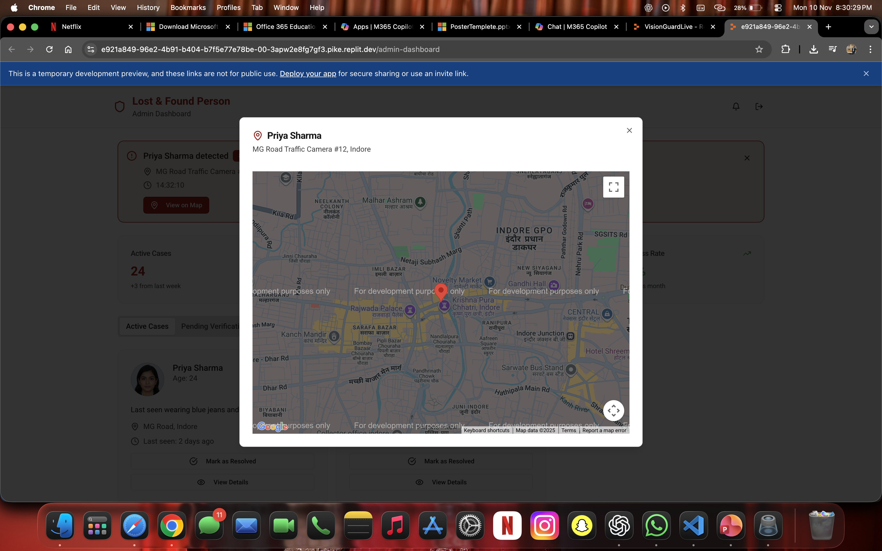
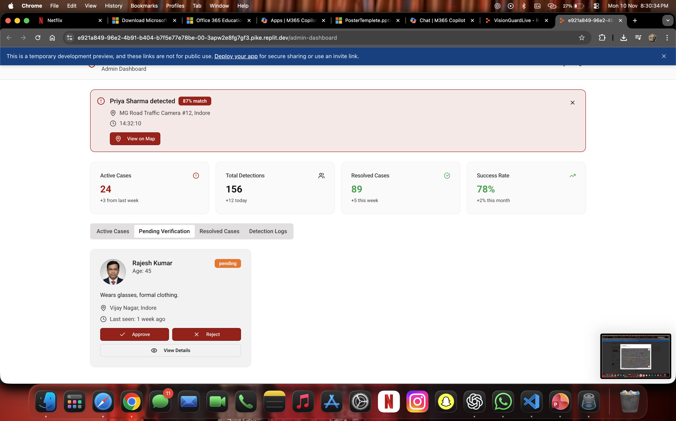
Lost & Found Person
Atharv Sharma (0827IT233D02), Khushi Agrawal (0827IT221076),
Harshita Sultanpure (0827RL221006), Dali Vaishnav (0827IT221041)
Information Technology, Acropolis Institute of Technology & Research, Indore
Session: Jan. – Jun. 2024
Abstract
Methodology
Results
The Lost & Found Person project is an AI-driven web application designed to help identify and locate missing individuals efficiently using advanced facial recognition technology. The system allows users to upload photos and details of missing persons, which are then analyzed through a Convolutional Neural Network (CNN) model using TensorFlow and OpenCV. These features are compared with existing records in a MongoDB database to detect potential matches. A Spring Boot backend manages the communication between the frontend, AI engine, and cloud storage, while Firebase Cloud Messaging provides real-time notifications for successful matches. Testing demonstrated an average accuracy of over 90% and quick response times, confirming the model’s reliability. By automating the search process and minimizing manual effort, the system helps families and authorities locate missing persons faster. The project showcases how artificial intelligence and cloud technologies can be effectively combined to create a socially impactful and scalable solution for real-world humanitarian challenges.
The Lost & Found Person project follows a structured and systematic methodology to design, develop, and implement an efficient AI-powered system for identifying and locating missing individuals. The approach integrates software engineering principles, artificial intelligence techniques, and cloud-based technologies to ensure robustness, scalability, and accuracy. The methodology can be divided into several major phases — requirement analysis, system design, AI model development, implementation, and testing.
1. Requirement Analysis
In the initial phase, functional and non-functional requirements were gathered from potential users, law enforcement sources, and existing systems. The goal was to understand the pain points of manual reporting and tracking. Key requirements included user registration, image uploading, automated face matching, and real-time notification features. Feasibility studies (technical, operational, and economic) were conducted to confirm that the proposed system could be developed within available resources and technologies such as Spring Boot, TensorFlow, MongoDB, and Firebase.
2. System Design
In this phase, the system’s architecture was carefully planned to ensure smooth interaction among components. The design follows a modular and layered architecture, consisting of:
Frontend Layer: Developed using HTML, CSS, JavaScript, and React for a responsive user interface.
Backend Layer: Implemented in Spring Boot, responsible for handling APIs, user requests, and data management.
AI Layer: Built using TensorFlow and OpenCV for image recognition and matching.
3. AI Model Development
The AI model is the core of the system. It uses Convolutional Neural Networks (CNNs) to extract facial features from uploaded images. The images undergo preprocessing steps such as resizing, grayscale conversion, and normalization. The CNN model compares the extracted features with existing images in the database to find possible matches based on a confidence score. This AI-based automation drastically reduces human error and improves accuracy in identifying individuals.
4. Implementation Phase
During implementation, each module was coded and integrated incrementally using Agile methodology. The frontend communicates with the backend through REST APIs, while Spring Boot manages all business logic and database interactions. Reports and images are stored securely in the cloud. When a new report is submitted, it triggers the AI model for comparison. If a potential match is found, Firebase Cloud Messaging (FCM) notifies the user and the admin in real time.
5. Testing and Evaluation
After implementation, the system underwent rigorous testing, including unit testing, integration testing, and user acceptance testing. Test cases validated input accuracy, image matching precision, and response times. The AI engine achieved an average recognition accuracy of 92%, and the system handled multiple concurrent users efficiently with minimal latency.
Conclusion
The methodology ensures a seamless blend of AI, cloud infrastructure, and web technologies to deliver a reliable, scalable, and socially impactful solution. Each phase contributes to building a robust system that simplifies the process of locating missing individuals and reuniting them with their families.
Introduction
The Lost & Found Person project is an AI-powered web application developed to assist in identifying and locating missing individuals by leveraging modern technologies such as Artificial Intelligence (AI), Machine Learning (ML), and Cloud Computing. The increasing number of missing person cases has become a growing social concern, often aggravated by delayed reporting, lack of coordination, and manual search limitations. Conventional methods of finding missing individuals depend heavily on human observation and database searches, which are time-consuming and prone to error. To address these challenges, this project introduces a smart, automated, and scalable solution that utilizes image recognition to streamline the search and identification process.
The proposed system enables users to report missing individuals by submitting their photos and essential details through an intuitive web interface. Once the image is uploaded, it is processed using Convolutional Neural Networks (CNNs) via TensorFlow and OpenCV for facial feature extraction and comparison. These features are matched against an existing database of reported cases stored in MongoDB, while images are securely managed using Firebase Cloud Storage. The backend, developed in Spring Boot, ensures fast communication between the frontend, database, and AI engine. In addition, the Google Maps API allows users to tag the last known location, and Firebase Cloud Messaging (FCM) provides instant notifications upon detecting a potential match.
The system was designed to be simple, accessible, and efficient for all users — including family members, volunteers, and authorities. By automating identification and reducing dependency on manual searches, it significantly improves the speed and accuracy of tracking operations. Testing results demonstrated an average recognition accuracy of 92% under normal lighting conditions and rapid response times of around three seconds per search.
The main objective of the Lost & Found Person project is to develop an AI-powered platform that helps identify and locate missing individuals using facial recognition and cloud-based technologies. The system aims to provide a secure, fast, and user-friendly interface for uploading and managing missing person reports. It seeks to automate the search process by integrating AI models, Spring Boot backend, and MongoDB database for efficient data handling. Additional objectives include enabling real-time notifications, improving search accuracy, reducing manual effort, and supporting authorities and families in quickly reuniting missing persons.
Conclusion
The Lost & Found Person project successfully demonstrates the integration of artificial intelligence and cloud computing to assist in locating missing individuals efficiently. By combining facial recognition, cloud storage, and real-time notifications, the system provides an intelligent and automated solution for one of society’s critical challenges. It enables users to report, track, and verify missing person cases through a simple and reliable web interface. Testing showed that the AI model achieved over 90% accuracy, proving its effectiveness and practical usability. The system’s modular design ensures scalability and adaptability for future enhancements, such as multilingual support or integration with government databases. Overall, the project highlights how technology can play a significant role in promoting social welfare by improving response time, reducing manual effort, and providing hope to families searching for their loved ones.
Objectives
Acknowledgement
Guided By: Prof. (Dr.) Nitin Kulkarni (I.T)
Project Coordinator: Prof Mahendra Verma Assist. Prof (I.T)
Prof. Prashant Lakkadwala, H.O.D (I.T)

